Slide 1
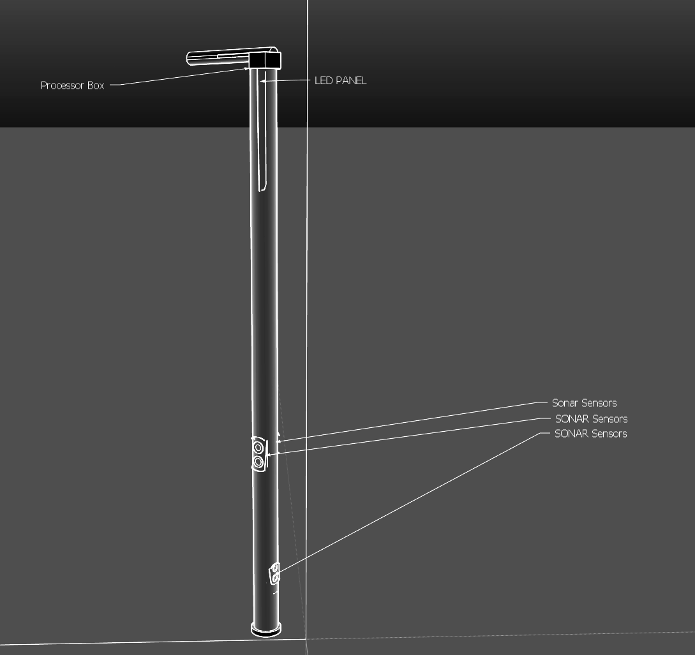

T06: Team Smart Cane
Shadman Samin, Dusan Micic, Nathan Pham, Keon Yoo

Slide 2
Outline
Need - Dusan
Motivation - Dusan
Objective - Nathan
Alternatives - Keon
Requirements - Dusan
Approach - Shadman
Software Design - Nathan
Hardware Design - Keon
Implementation Schematic & Board - Shadman
Implementation Code - Shadman
Tools - Keon
Testing - Nathan
Results - Nathan
Contribution & Lesson’s Learned - Dusan

Slide 3

Need
The need for a visual assistance cane arises whenever a person has trouble identifying obstacles while walking on a day to day basis.
The reason can range from partial blindness to perpetual unawareness of one's surroundings

Slide 4
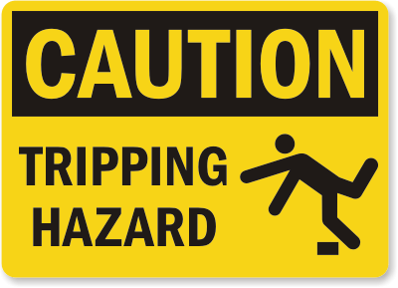
Motivation
This invention has the potential to prevent injuries due to tripping or colliding with objects.
This in turn can save money by avoiding potentially costly medical bills

Slide 5
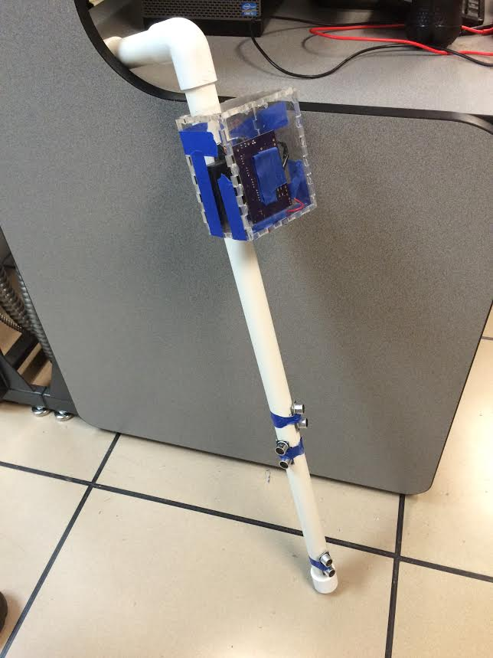
Objective
The goal of this project was to design and build a working prototype as a proof of concept

Slide 6
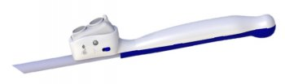
Alternatives
Today, walking canes do not incorporate sensors for object detection nor do they provide feedback. The is a smart cane specifically for the blind however that incorporates similar technology.
Other similar products include canes with GPS to help with directions.

Slide 7
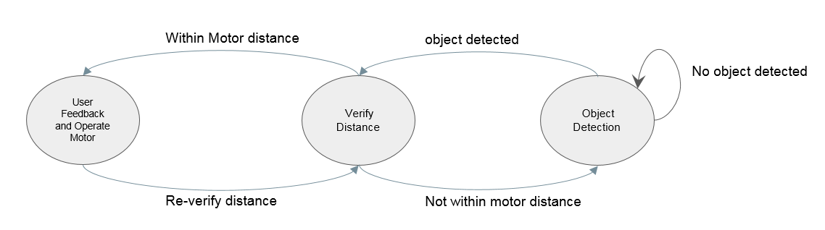
Requirements
Ideally a completed device would detect an object at 30cm in front of the operator or 10cm to the sides of the operator. The device would then provide haptic feedback in the form of vibration of the cane to alert the user of an obstacle

Slide 8
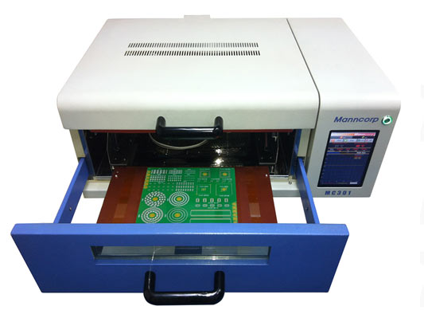
Approach
Familiarized ourselves with microcontrollers and their programing
This includes how they interact with the ultrasonic sensors
Designed the circuit in Eagle
Designed a PCB in Eagle based on the circuit
Ordered the necessary parts
Populated board and soldered it in a reflow oven
Built prototype using PVC pipe

Slide 9
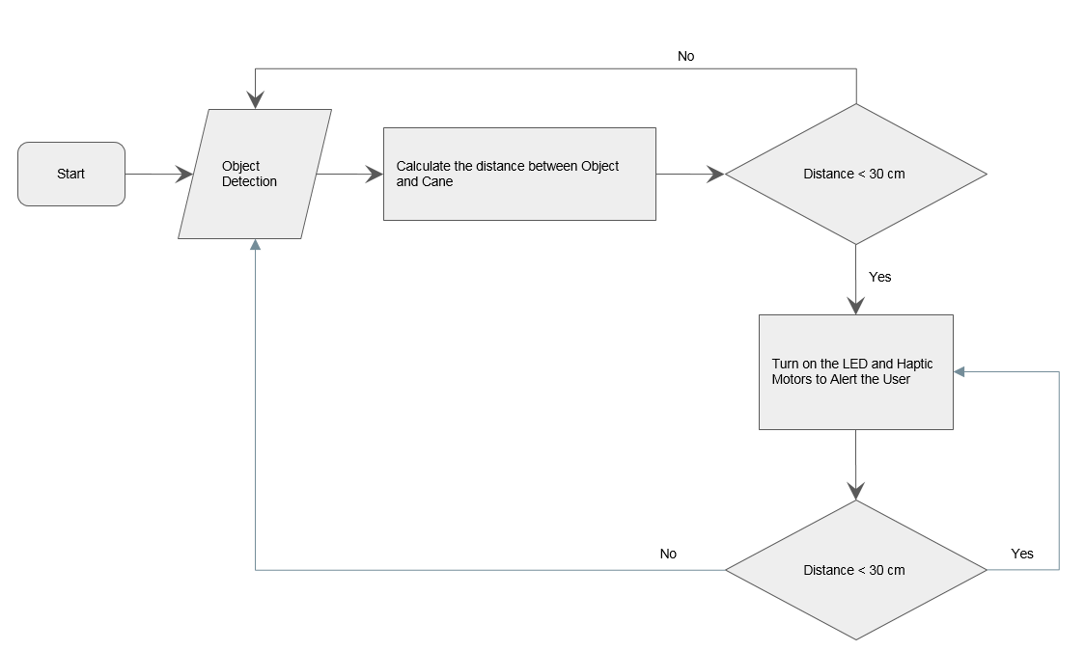
Software Design

Slide 10
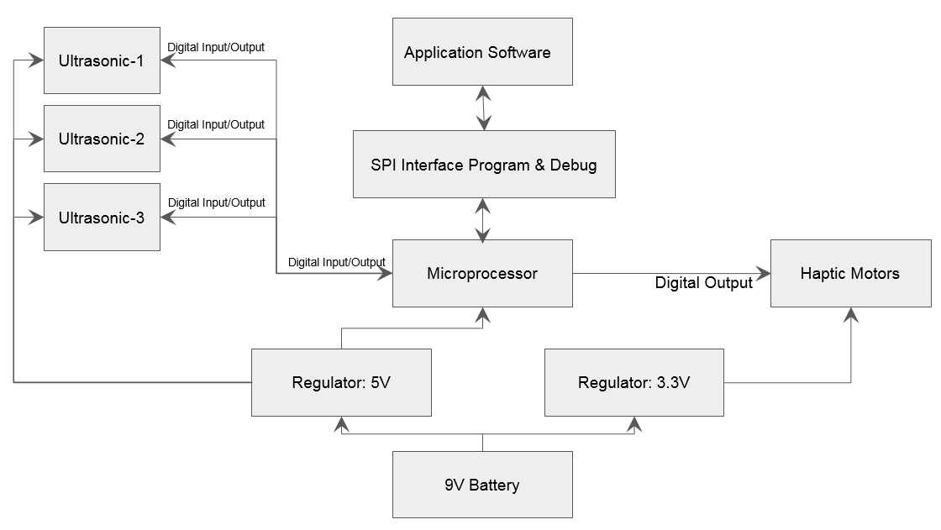
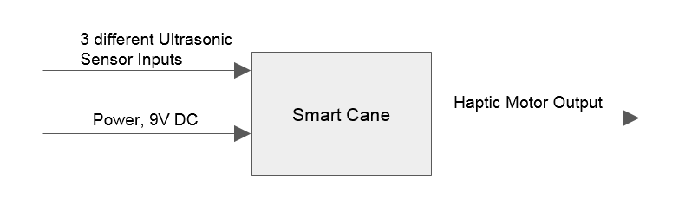
Hardware Design
Level 1 Block Diagram
Level 0 Block Diagram

Slide 11
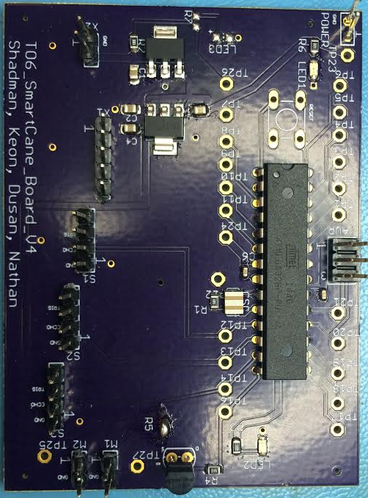
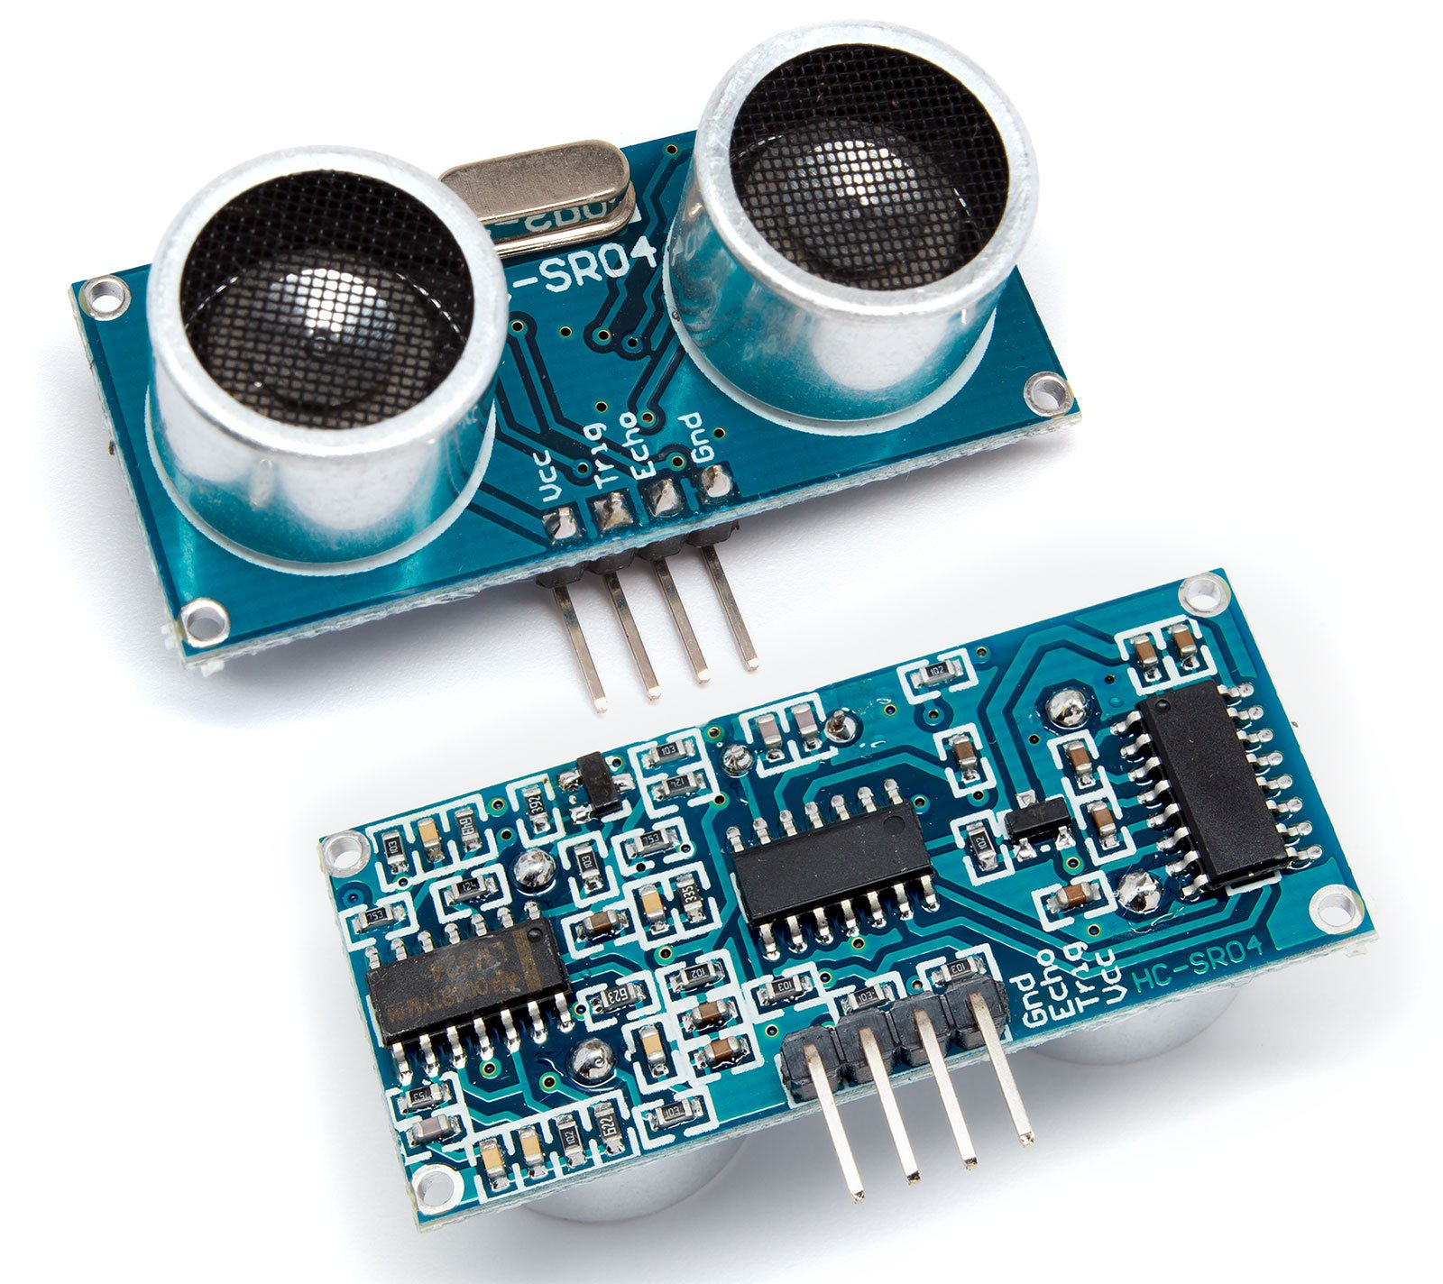
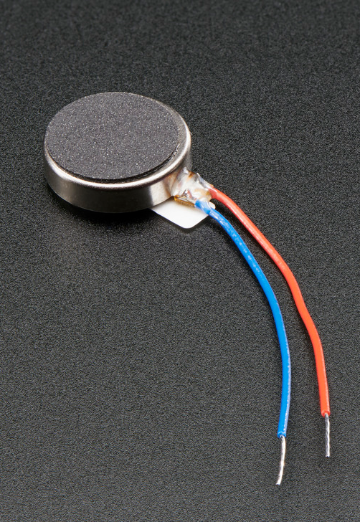
Implementation: Major Components

Slide 12
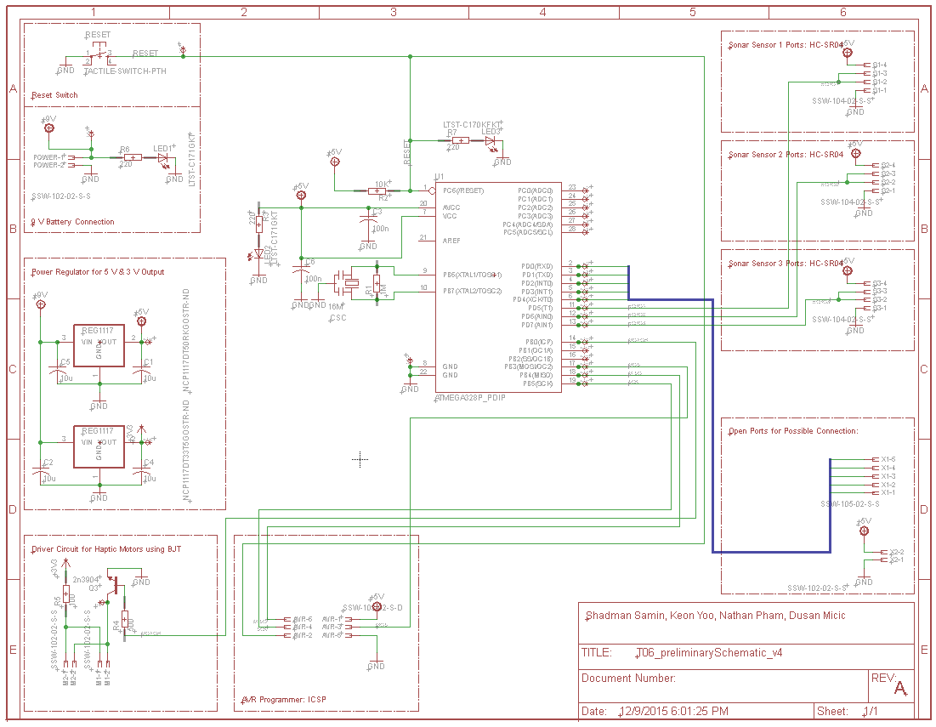
Implementation: Schematic and PCB

Slide 13
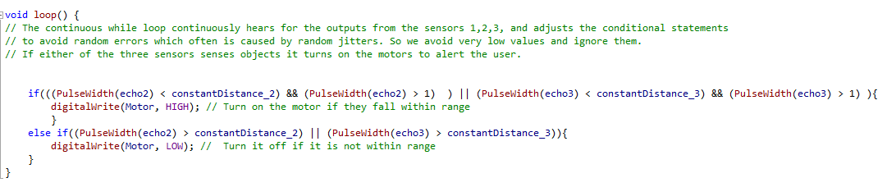
Implementation: Code

Slide 14


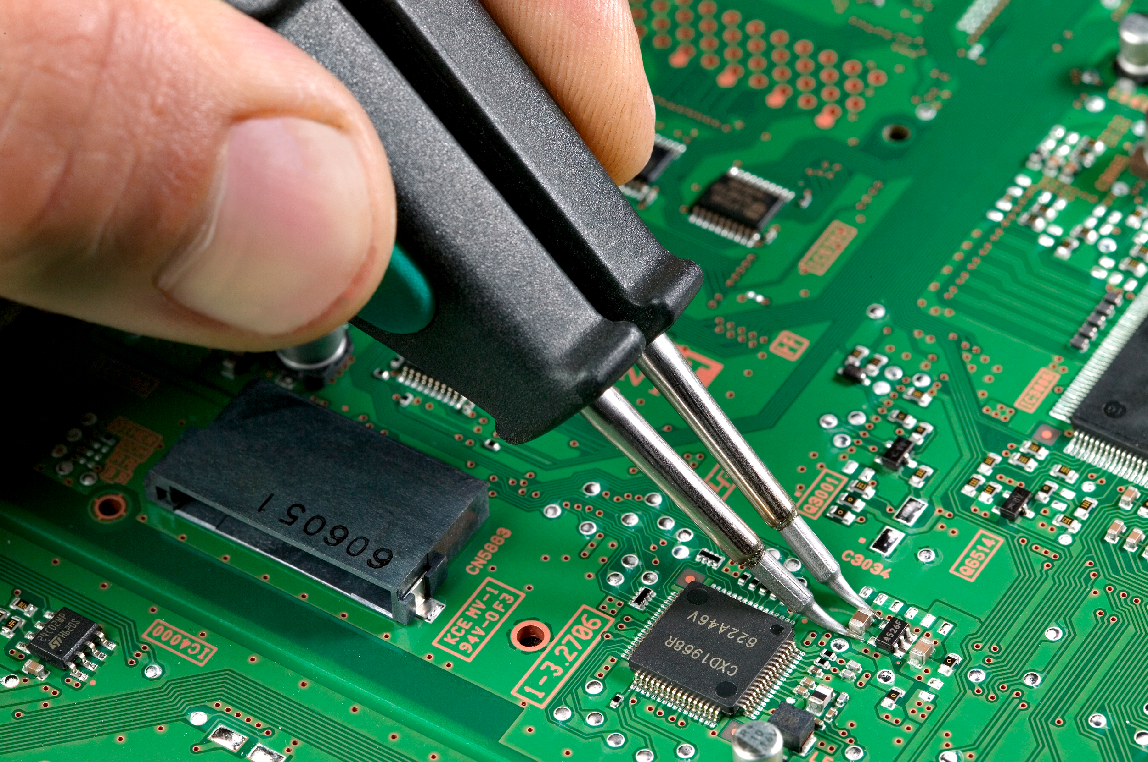
Tools
EagleCAD for schematic and PCB design
LTSpice for necessary simulations
SMD soldering equipment
Laser cutter

Slide 15
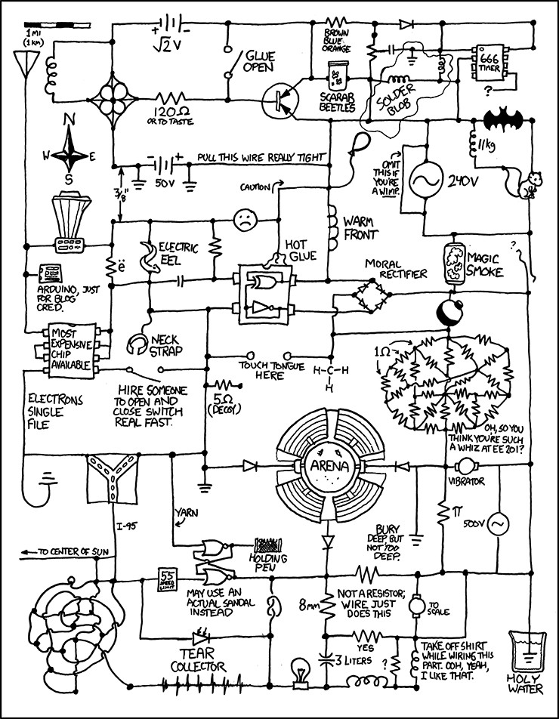
Testing
Module Test
Battery life
Integration Test
Interaction between sensors and microcontroller
Microcontroller to vibration motor
Parametric Test
Output voltage high and low test
Frequency of detection
Functional Test
Accuracy of Sensor
Environmental Test
Water resistance
Humidity test

Slide 16
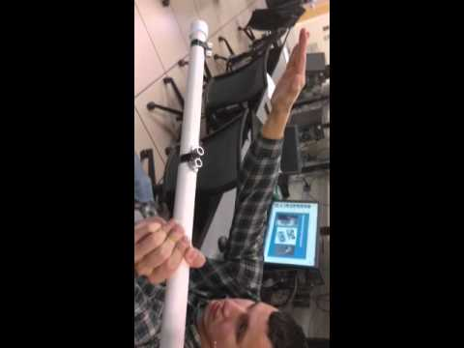

Slide 17
Results
The SmartCane met all the “must” requirements
In addition, the cane meets a number of the “may” requirements
The sensors seem to interfere with each other in some cases
This led to us removing one of the sensors in order to decrease the number of variables

Slide 18
Contributions
 | Dusan | Nate | Shadman | Keon
Schematic Design |  |  | X
PCB Design | X |  | X
Homework Writeups | X | X | X | X
Programming |  | X | X | X
Board Population | X | X | X | X
Soldering | X | X |  | X
Debugging | X | X | X | X
HW fixes |  | X |  | X
Presentation | X

Slide 19
Lessons Learned
Expect the unexpected
If it's not broken, don't try to fix it
Double check that the parts you ordered are the right size
SMD soldering skill greatly improved
Waterproofing is not as easy as covering everything in hot glue
Always use Arduino if you can, don't try to get fancy
Research parts heavily before buying them

